Slide 1
Botox in thyroid eye disease
Lionel Kowal
Australia

Slide 2
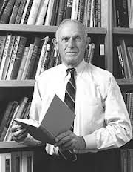

Alan Scott
We are all the beneficiaries of his imagination, his science, his integrity, his wisdom & the generosity of his teaching
We all stand on the broad & strong shoulders of this intellectual giant

Slide 3
Botox in thyroid eye disease
Should it work?
…in a muscle that is ‘fibrosed’ or ‘inflamed’
Does it work?...if not, why not?
..is it the Botox that is working, or a non – specific effect of an intramuscular injection into an abnormal muscle?
Is it safe?

Slide 4
Is it fibrosed?...inflamed? feldon
…in TED, signs, especially strabismus, tend to worsen as the inflammation decreases. Scarring is the final step in the healing process. The so-called inflammatory signs are mostly signs of high venous pressure within the orbit rather than actual on-going autoimmune infiltration of inflammatory cells.

Slide 5
…. animal model of orbital venous obstruction by ligating the draining ophthalmic veins of the right eyes of 4 cats. … there was .. marked proptosis, chemosis, and exotropia.
Histology showed acid mucopolysaccharides, increased collagen …lymphoid cells ……persistent interstitial lymphocytic infiltrates graefe’s arch clin exp ophthalmol 1996

Slide 6
Without evoking a primary orbital inflammation or inducing a systemic autoimmune disease, an animal model of venous stasis has been developed that closely mimics many of the advanced clinical and histologic changes that occur in GO graefe’s arch clin exp ophthalmol 1996

Slide 7
Fibrosed? Inflamed? Congested?
‘Orbital inflammation’ is sometimes / regularly relieved by orbital decompression

Slide 8
Fibrosed? Inflamed? Congested?
Confused?
In TED, the clinical pictures of inflammation, venous congestion & fibrosis overlap and cannot be reliably distinguished
There will be some / a lot of unrecognised selection bias in every cohort

Slide 9
‘Fixed muscle shortennig’
Simonsz
Is the muscle irreversibly ‘fibrosed’?...or is it reversibly contracted?
Is it inflamed or is it all venous congestion, or both?

Slide 10
L-T measurments
7 pts with recent onset GO. Affected muscles were stiff.
When the other eye looked out of the field of action of the muscle, it lengthened.
..the raised muscle tension and reduced elasticity of the involved muscles were primarily caused by active muscle contraction and not by fibrosis
…so Botox should work
Force-length recording of eye muscles during local anesthesia surgery in 32 strabismus patients
Simonsz HJ Strabismus. 1994. Vol 2. pp 197-217

Slide 11
=
8 pts with endocrine orbital myopathy received BT in extraocular muscles……
Strabismus of ≤25Δ, especially during early stages of eye muscle involvement, responded well to injection with realignment and ….. avoidance of fixed muscle shortening.
Long-standing strabismus, large angles ….. responded less well

Slide 12
Alan Scott
Works very well in 10-15%
An effect in a further 20%
Ineffective in most

Slide 13
David Granet ucsd WCPOS 2012
Use 5-15u
Overall 1/3 pts avoid strabismus surgery
Success better < 20Δ

Slide 14
botulinum toxin A in the treatment of restrictictive strabismus in thyroid associated ophthalmopathy [Chinese]
Zhonghua Yan Ke Za Zhi. 2006 Dec;42(12):1063-7.
BTX injection has a good effect in the treatment of restrictive strabismus in TAO. Better results … when treated earlier. Compare with paralytic strabismus and comitant strabismus, the dosage of botulinum toxin A in each injection in TAO is higher, the mean changes of degree of deviation is slighter, the interval between injections and the duration of effect is shorter. Injection dosage should increase after repeated injections. Intolerable diplopia could be eliminated in some patients, therefore, a muscle surgery could be avoided.

Slide 15
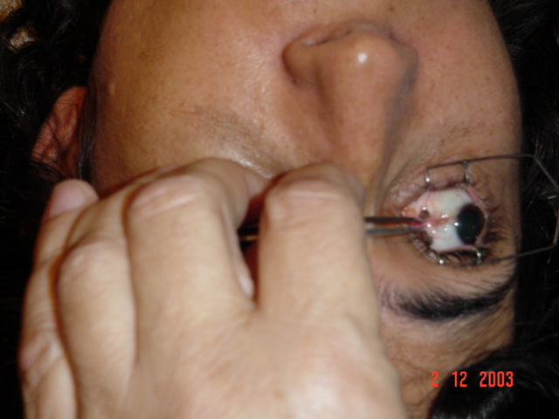
How?
1. EMG
2. Mendonca forceps
3. Dose: stopped trying 2.5u or 5u.
I start with 10u.
If zero effect, try 20u

Slide 16
Kraft : is it the botox, or is it any intramuscular injection?
Many years ago one of my oculoplastics colleagues who used to do lots of thyroid orbit surgery .... asked if the Botox injection actually did very much in these patients or was it really the fluid itself that physically separated fibrils and may release restrictions.
I did a small controlled study (…no more than 3 or 4) … I only injected saline under EMG guidance into thyroid inferior rectus muscles. Each case had a hypotropia > 20Δ.
3/4 eyes improved significantly so that no surgery was needed. … result stable for at least 6 mo ….
The inferior ductions were temporarily worse (no more than -1) for a few days then returned to almost normal in downgaze, even though the alignment in primary position stayed satisfactory.

Slide 17
My Very 1st thyroid Botox pt
30-35^ hypo
10u to IR
W2: perfect, and stayed that way.

Slide 18
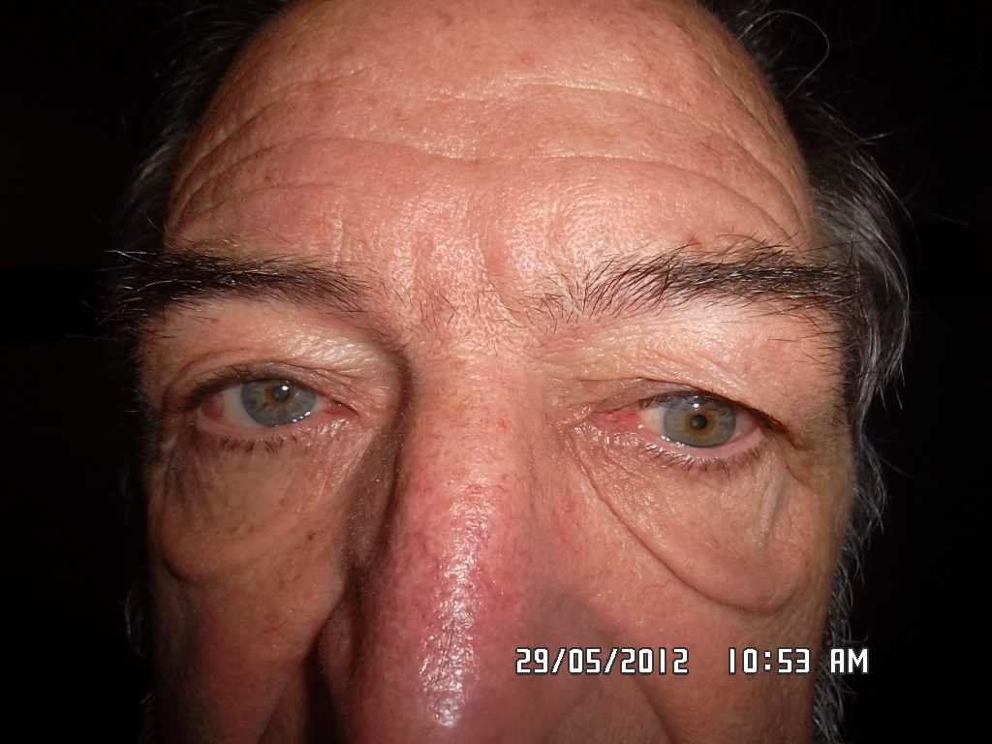
Pt 1 55404 WM age 73
Tight LIR
20u: no effect
Surgery 7w later

Slide 19
Pt 2 50170 WF age 77
ET 25, LH 25
RMR Botox 20u:
D7 no ET, RMR-2, slow saccade.
M3: ET returned

Slide 20
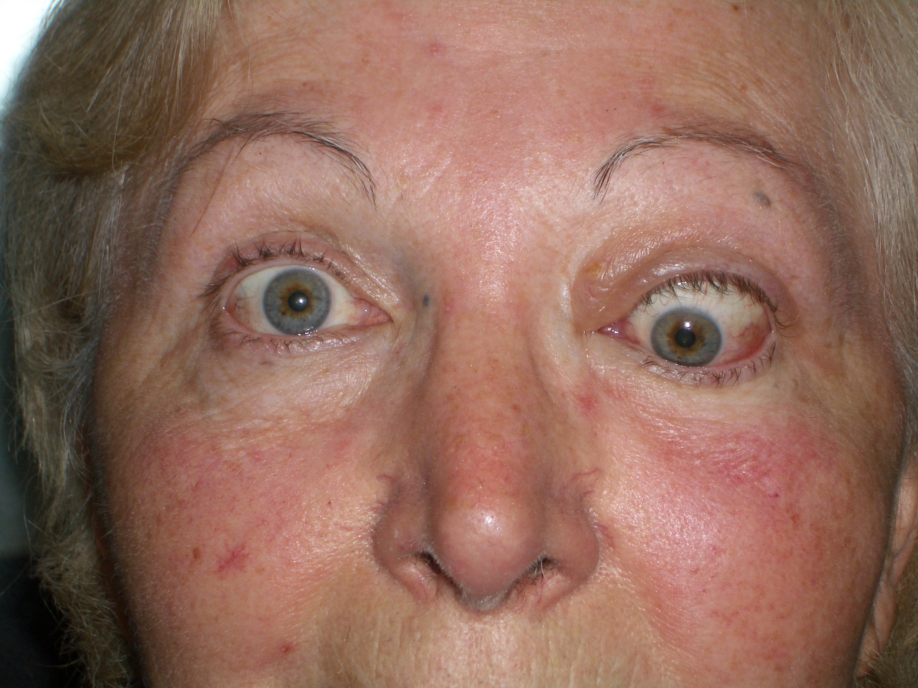
Pt 3 49601 WF age 64
Tight LIR: 20u EMG no effect
Repeated 1w later: no effect

Slide 21
Pt 4 49996 WM age 48
ET Δ : R gaze 30+, primary 20+, L gaze 14
Adjustable BMR
Early recurrence (D6: 8-12-0, D13: pp 20
D18: 20u Botox to RMR
D9 post Botox: ET 2
D41 post Botox: ET 25
W11: 25-25-14
W16: re-Rc MR OU [Traboulsi]
D1: ET 12, EX’=0
W3 post 2nd surgery: ET 14, EX’=0

Slide 22
Pt 5 WM age 52
….who still smokes.
A year or so ago, 5u worked really well for 3 mo [large range of single vision]
More recently, 5u didn't work @ all.
10u lasted 1 week.
15u worked really well but only lasted 3 weeks.

Slide 23
Moorfields experience 1
N=38 3/38 decompression; 6/38 previous strab surgery
Mean hypo 23Δ[4-60]
Mean ET 28Δ [14-45]
IR 32, MR 5, LR 1
26/38 had subsequent strab surgery
6/38 stable long term result from BT
1: one shot IR, now 2^ hypo
2: 2 shots for 16 ^ hypo
3: one shot fixed 14^ residual ET
4. 6^ hypo fixed with 2 shots
5: 2 shots improved 27^ hypo to 12^, controlled by AHP
6. 2 previous strab surgeries. One shot fixed residual 24^ hypo
C. J. LYONS, S. F. VICKERS, J. P. LEE
Botulinum Toxin Therapy in Dysthyroid Strabismus Eye(1990)4,538-540

Slide 24
Moorfields experience 2
N=65 8/65: stable long lasting improvement
5/8: only 1 shot
4/8: previous strab surgery
7/8: IR, mean 17Δ
1/8: LR. 30Δ
6/8: no Δ
3/65: ~ yearly injections
51/65: little/ no effect
1st shot: little/ no effect – subsequent shots no better
Hypo mean 23Δ, range 3-60. Effect of BT 8Δ, range 0-28
ET 32Δ, range 4-65. Effect of BT 23Δ [8-54]
Gair, Lee, Khoo, Maurino
What is the role of BT in dysthyroid strabismus? JAAPOS 1999; 3:272-4

Slide 25
Ooptic neuropathy associated with BTA in thyroid-related orbitopathy.
Korn BS, Seo SW, Levi L, Granet DB, Kikkawa DO
Thyroid Eye Center, ucsd
Ophthal Plast Reconstr Surg. 2007 Mar-Apr;23(2):109-14
@ 3w follow-up after BTA injection, 3 pts were noted to have clinical signs and symptoms of optic neuropathy in the ipsilateral eye.
Treatment with oral steroids followed by orbital wall decompression reversed the optic neuropathy.

Slide 26
BOTOX IN TED summary
Definitely some successes
There is unknown selection bias in all the studies

Slide 27
How do we do it better?
Need better ways to determine activity vs congestion vs fibrosis
Kraft study too intriguing to ignore
Prospective studies

Slide 28
Your next pt
Tell them it is 99+% safe
It usually doesn’t work, it sometimes helps

